Slide 1
Unique Corns
Parth, Allen, Clare,
Jenny, Pascal, Patrick

Slide 2
Questionnaire Results:

Slide 3
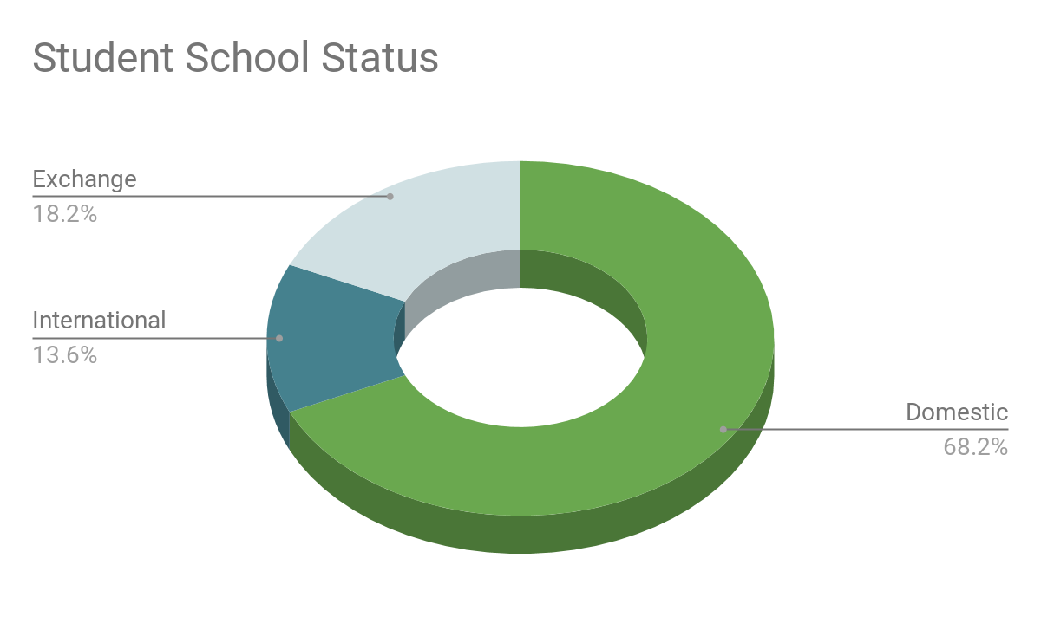
Participant Demographics
Currently 20 participants (ongoing)
12 Female, 7 Male, 1 Other
Including:
UTSG (65%) + UTM (35%)
Commuters (60%) + Non-Commuters (40%)
18-22 year old
Notes:
All ages reported within expected ranges for uni students (18-22)
Only one exchange student participated in any kind of club but they average 4.25 for importance of social stuff
Domestic students averaged 3.6 for importance of social aspects
International students averaged 3.7
Can maybe mention about asking different campuses to broaden our scope (since people were saying how we are only focused on U of T).

Slide 4
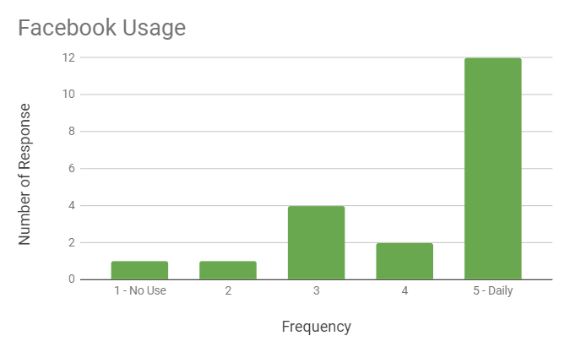
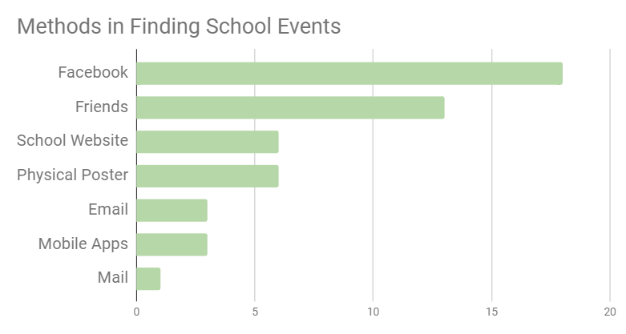
What are used to find social events?
Majority of the students used Facebook and friends as their main tools to find social events

Slide 5


Social Media Usage
Most commonly & frequently used social media is Instagram
16 daily users
No survey participants did not use it
12 daily users
1 participant did not use it
Notes:
WeChat came last - but is that a demographic issue from our survey recipients?
14/20 respondents did not use twitter, 18/20 did not use WeChat
Only two people did not list facebook as a method of finding events, even though 4 positive respondents use it a few times a week or less

Slide 6

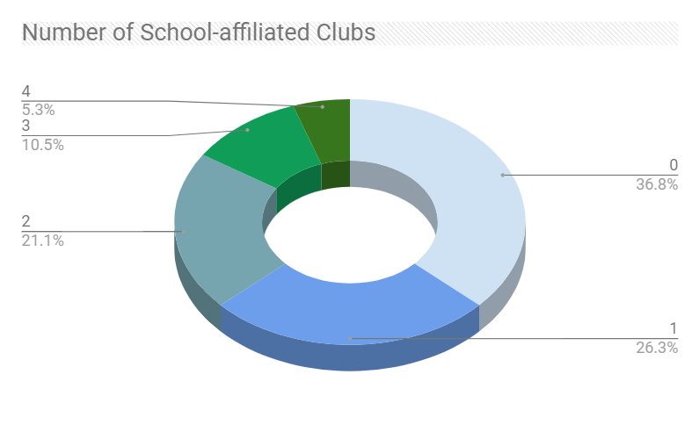
Club statistics
Most students are not involved in school clubs.
Those who are commented on the need for:
Large platforms to advertise events
Funds / Money
Notes:
Also requested was some kind of club page on quercus or similar
1 of 3 money requests was from someone who wasn’t involved with a club

Slide 7
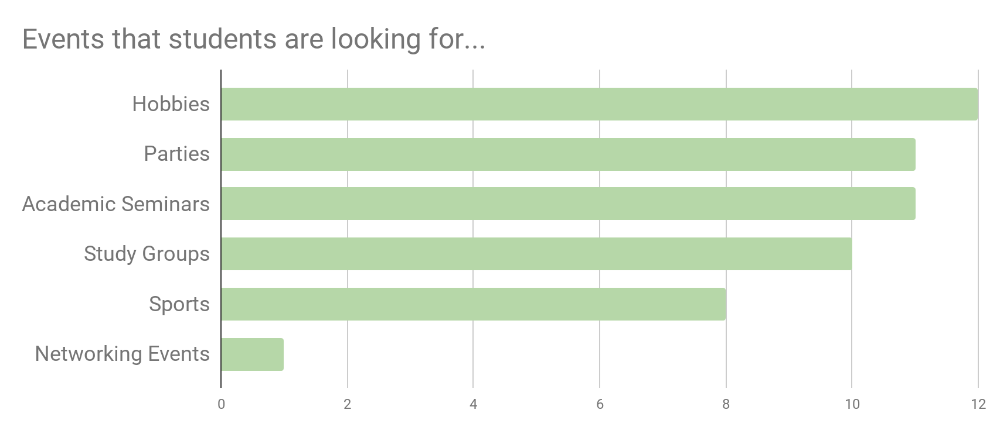
Main Findings
Many students are looking for different events (academic seminars, study groups, parties): this shows that differents students are actively looking for different events
Notes:
Worth noting there is a subset of students simply not interesting in social activities, we don’t have sufficient data to point to what proportion of the student community this would be, but needs to be acknowledged
Instagram is the most popular social media, but is never used as a source for events - idk if this is even useful since that just isn’t its purpose

Slide 8
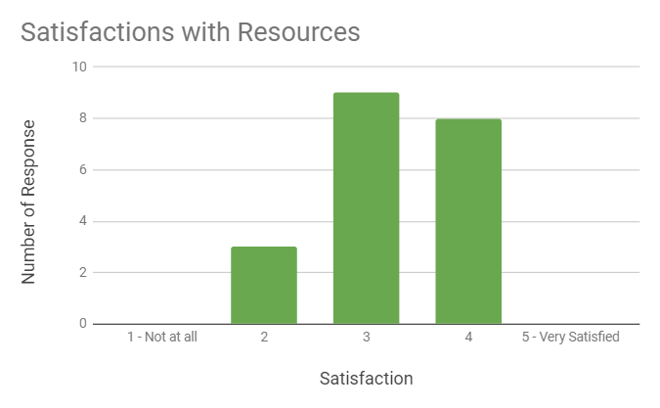
Main Findings
Many students indicated the use of Social Media and School websites to find social events, but they were not overly satisfied.

Slide 9
“More community feel is needed. We study way too much”
…
“There could be more, but the amount made is understandable. We all have different schedules and not everyone can be lined up.”
…
“In the hustle around such an academically driven institution, you can quickly get lost in homework and assignments and lost your connection to the community.”
...
Notes:
When asked about why social engagement is important to them?

Slide 10
Old problem statement
Transitioning into a new community can be difficult or even challenging for some. We are unaware of many events that happen around us and we miss the opportunity participate in things that interest us as well as a chance to meet new people.
Our vision is to develop a solution which can give
people who are new to communities an opportunity to connect with people around them who share the same interests.

Slide 11
Refined problem statement:
We would like to focus on making connections between students and their fellow peers in a course/program to strengthen ties between students and within their academic community.
Our focus is on students who want to balance their academic and social lives.
Specifically on helping students maintain and use their social network throughout their studies to promote.

Slide 12
Design of Formative Study 2
Interview

Slide 13

Design of Formative study 2:
Target participants
Questionnaire participants
Offer coffee + refreshments in exchange for interviews
Protocol
Finalize script for interview
Email + Phone set up a meeting
Consent form + Demographic form
Note + Record the Interview
Notes:
We have 7 people interested to follow up with an interview
Offer free coffee and baked goods in exchange for participation in interview

Slide 14
Interview Questions Draft:
Community within courses/programs:
Describe your social life?
Do you feel a strong sense of community within your program of study? Why?
Do you socialize with fellow students in your courses? Give an example of how you made that social connection.
What are the greatest challenges in making connections with other students in your courses/program?
Hobbies and interests
What are some of your interests/hobbies? Are you involved in any extracurriculars that help develop that interest?
Do you know of other people in your program/courses with similar interests
Resources
What wa the last social event you attended within U of T? How did you find out about it?
Notes:
We should ask interview participants that are involved in a club if they follow that club’s instagram

